Slide 1
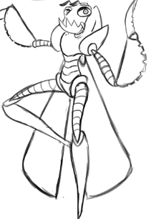
Unity Game Software Requirements Specifications
Team members: Anthony Jamora, Thomas Burke, Jonathan Nabors

Slide 2
Problem Description & Scope
A team of students from the College of Creative Studies have built up a collection of artwork including 3D models, textures, video, and sounds. However, they lack the training and experience needed to implement and combine all of these assets in code.
Demo
1 Island
User-Controlled camera
Appropriate animations & sounds
Combat system
Functional UI

Slide 3
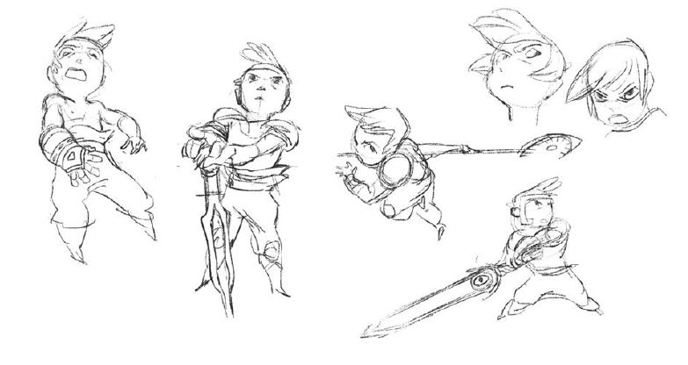
Game Description
WORDS
SECOND LINE
THIRD LINE

Slide 4
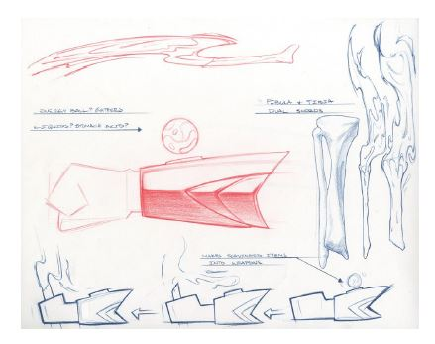
Functional Specifications
Game mechanics

Slide 5
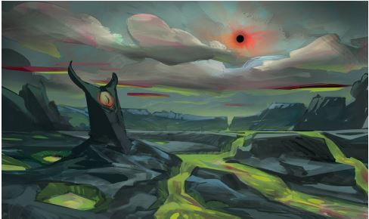
User Interface and Menus
FIRST LINE
SECOND LINE
THIRD LINE

Slide 6
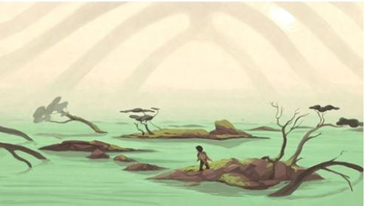
Art & Video
Terrain
Game Play Elements
Special Effects
Marketing and Packaging Art

Slide 7
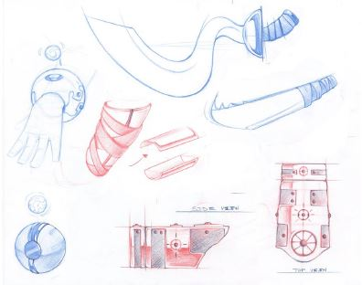
Sound and Music
Audio Sources

Slide 8
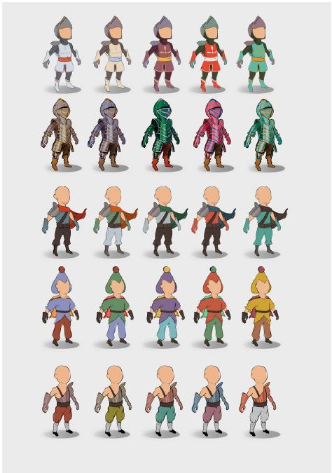
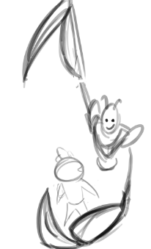
Characters
Player
Secondary
Enemies

Slide 9
Level Requirements
Level Diagram
Asset Revelation Schedule
Level Design Seeds

Slide 10
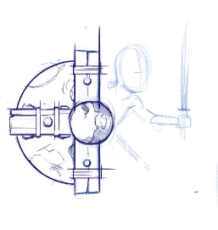
Technical Specifications
Game Engine
Platform and OS

Slide 11
Production Schedule
Scope
Scheduling
Dependencies
Cost Estimate

Slide 12
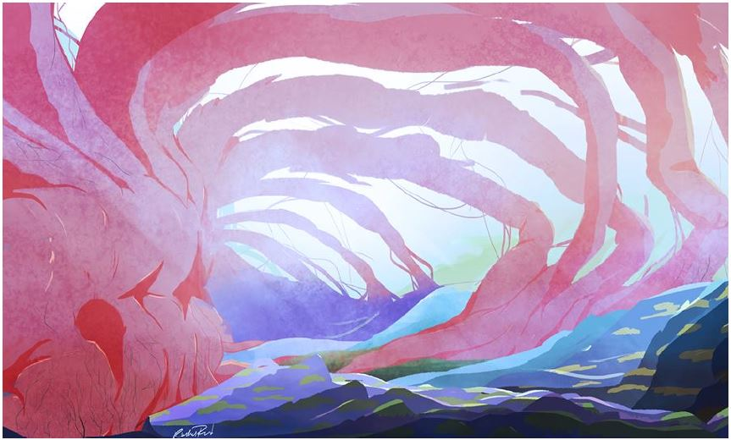
Use Cases
Actors
List of Use Cases
Begin new game

